Slide 1


Team 71: Microservices Management for Distributed Computation Bi-Weekly Update 2 Elizabeth Weichel Sponsor: Dr. Srinivas Shakkottai PhD: Ujwal Dinesha Master’s: Prathik Vijaykumar TA: Souryendu Das
Notes:
Michelle

Slide 2
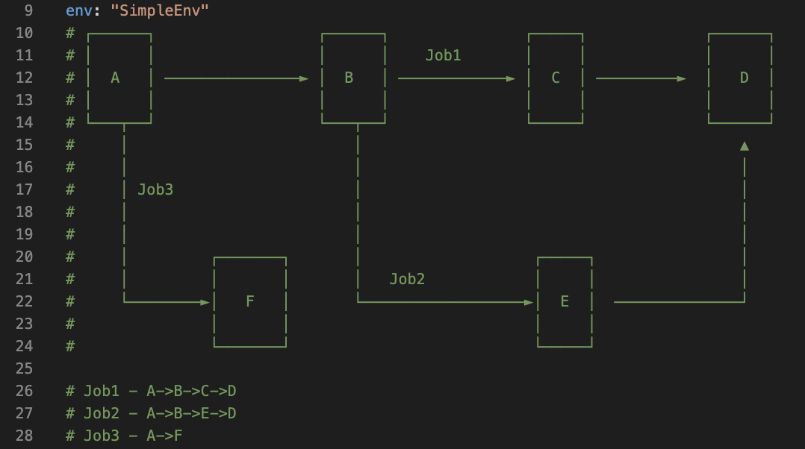
Project Summary
Problem: Autoscaling microservices using ML (& RL)
Goal: Previous research focuses upon e-e latency, and autoscaling individual containers, we will focus on container-level latency and combinations of possibilities for containers
Screenshot from simpleenv, the first microservices environment used with the simulator. Written by Ujwal Dinesha.
Notes:
Kyle

Slide 3
Project/Subsystem Overview
Simulator
Real System
Testing functionality ✅
Testing basic algorithms
Testing complex algos
Testing functionality
Testing basic algos
Testing complex algos
Notes:
Eric

Slide 4
Project Timeline
Simulator finished (completed 2/4) | Simulator tested without algorithm (completed 2/5) | Simulator tested with basic algorithms (to complete by 2/20) | Tree-based bandit tested on simulator | Real system complete (3/6) | Algos tested on real system (4/3) | Data compiled and robustness of systems tested w/ simulator vs real (4/17) | Complete system eval report (5/1)
Part of this will also involve implementing previously made algos on our system in order to give us targets for our algo to beat.
Notes:
Eric

Slide 5
Container Level Latencies
Accomplishments since 403 5 hours effort | Ongoing progress/problems and plans until the next presentation
Using .proto file and grpc to harvest container level latencies from jaeger rather than lookback for .jsons | This should be finished by next presentation

Slide 6
Simulator
Accomplishments since 403 4 hours effort | Ongoing progress/problems and plans until the next presentation
Worked on a function call that simulates one timestep within the simulator | Continued testing to ensure proper functionality (this will occur in concurrence with testing new algos)

Slide 7
Simulator Testing
Accomplishments since 403 5 hours effort | Ongoing progress/problems and plans until the next presentation
Tested a variety of different situations (will be shown further) | Pivoting from testing functionality and moving into basic algos, previously made (COLA), and new complex algos

Slide 8
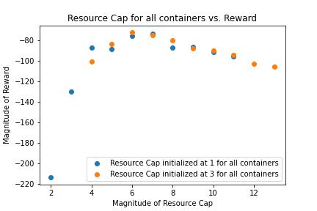
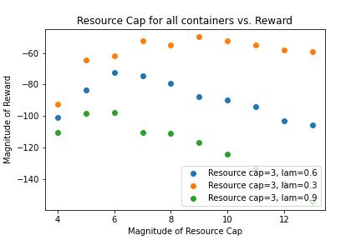
Data from Initial Testing
Initial test. Shows a horizontal shift , however same pattern.
reward=-(sum(latencies)+lamda*allocation)

Slide 9
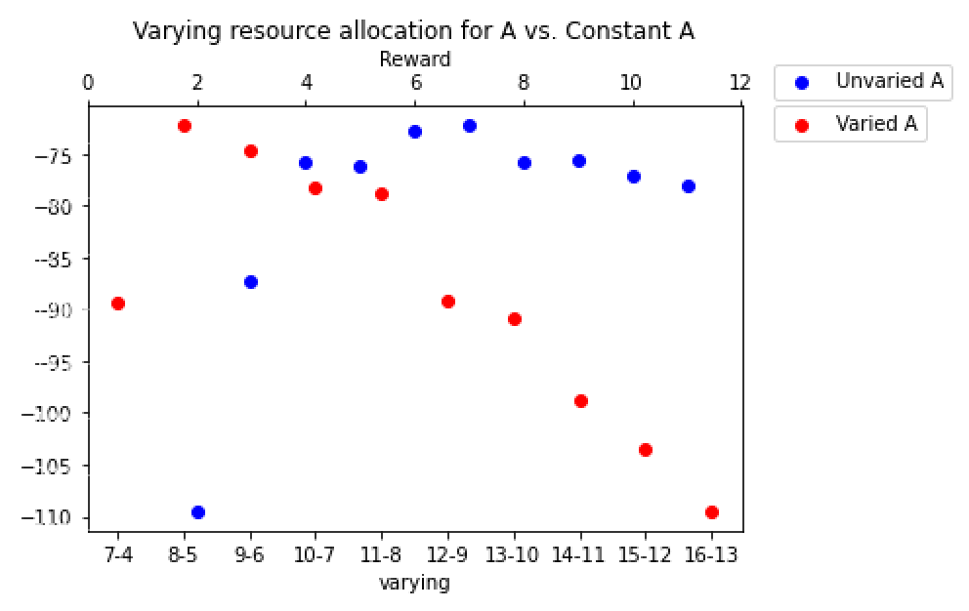
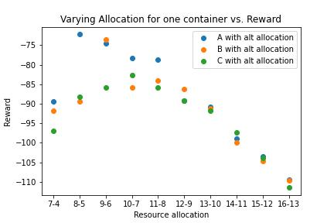
Data from Initial Testing
Essentially this is showing a horizontal shift. For varied A, it begins at much higher allocation which is bad for reward.
When treating all containers with equal latencies, varying individual allocations shows a similar pattern for all.

Slide 10
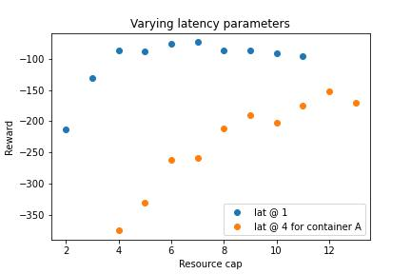
Data from Initial Testing
Current latency function:
lat(node)=(latency weight)/(resource cap)

Slide 11
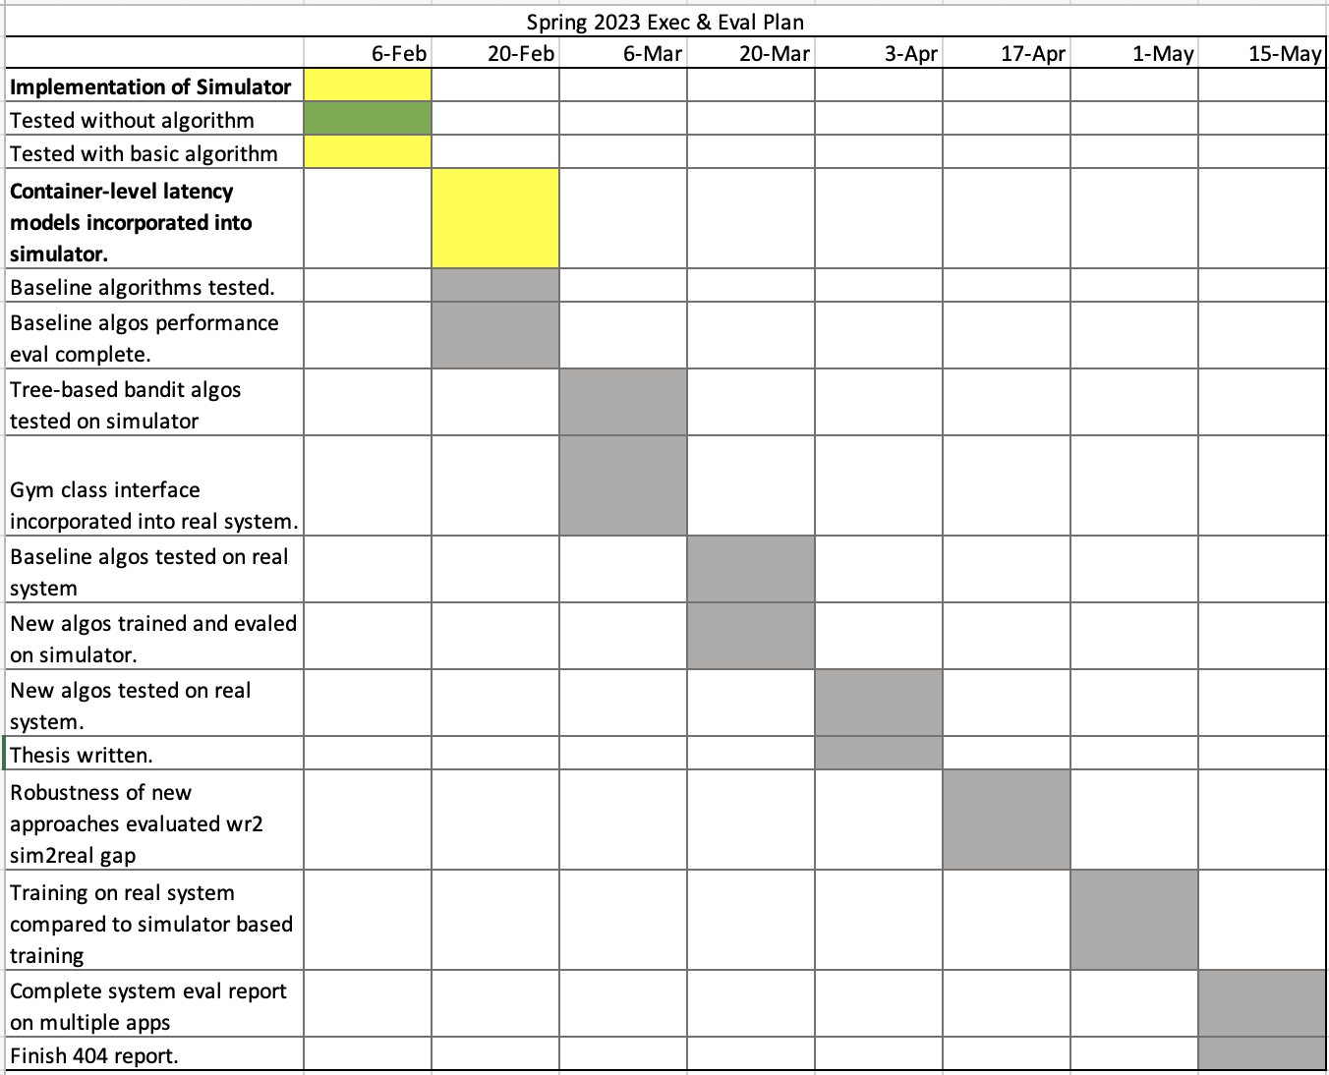
Execution & Plan
Execution plan
Your team planned milestones for completion of any remaining subsystem functionality, integration of specific subsystems, test, and validation plans should be presented.
Milestones should have owners … things like final integration can be group owned
Gantt chart – should indicate some 404 progress.
Notes:
Michelle

Slide 12
Questions?

